Slide 1
N-gram based input text predictor
钱钧 2120151028
Email : jaydone726@gmail.com

Slide 2
N-gram prediction
n-gram : contiguous sequence of n items from a given sequence of text or speech.
How to predict : eg. To be or not to (?) : search from 6-gram, 5-gram, list the probability.

Slide 3
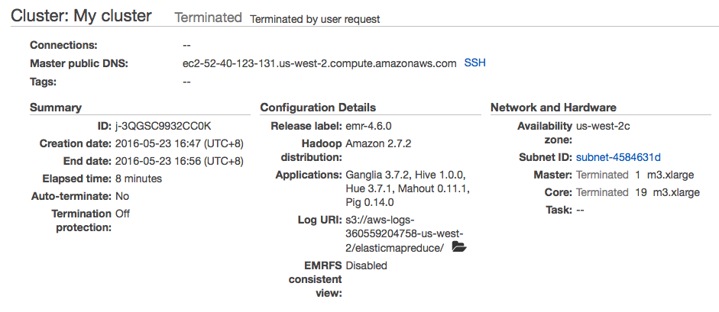
Amazon emr

Slide 4
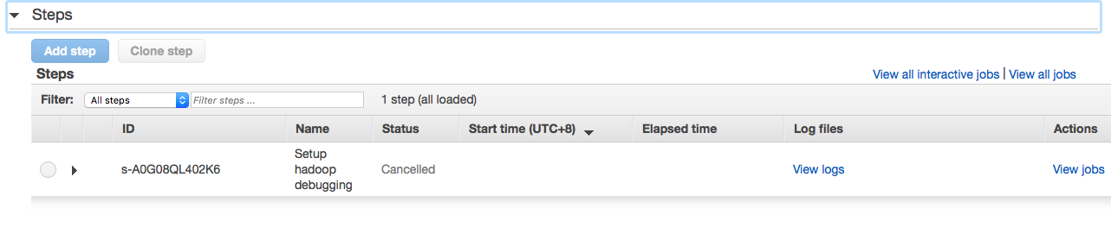
ADD STEPS

Slide 5
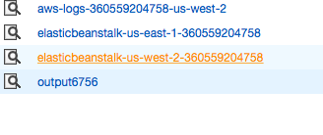
Amazon s3

Slide 6
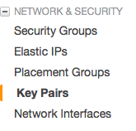
Key pairs
Using key pairs to connect remote clusters. First using cli tools. Then run java code using java jdk.

Slide 7
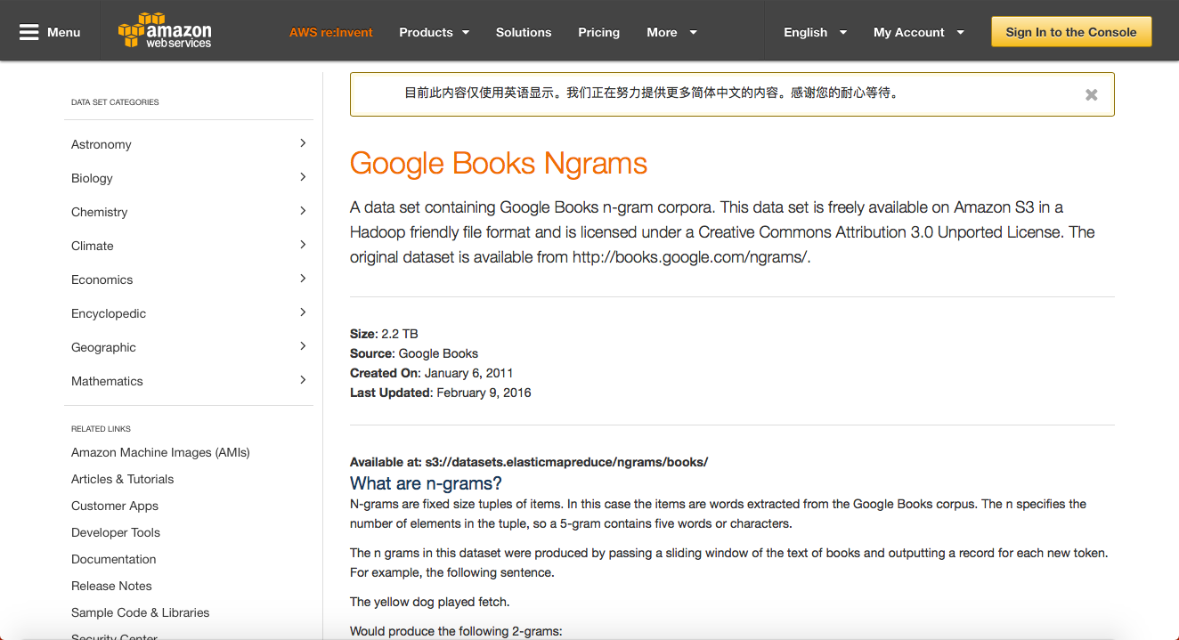
Data source
Google books

Slide 8
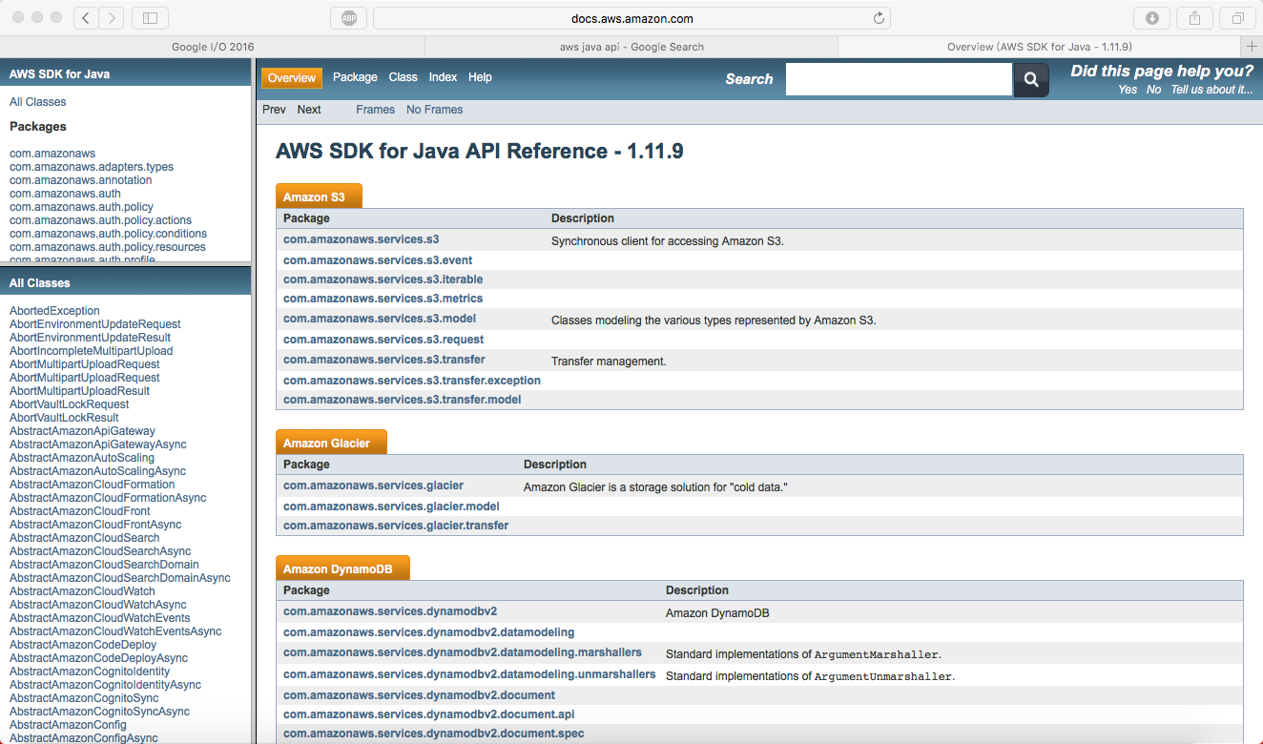
Aws java sdk

